Slide 1
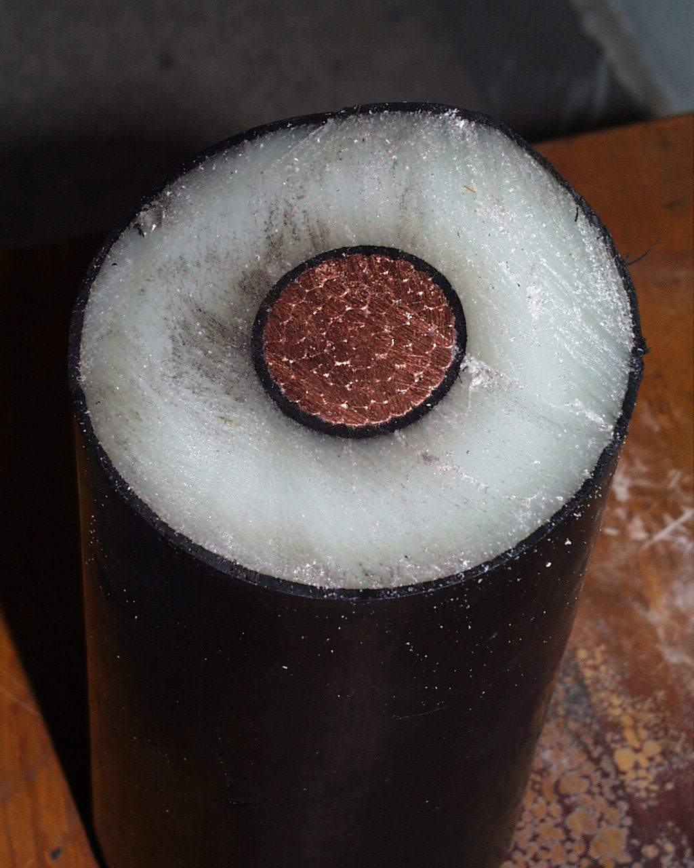
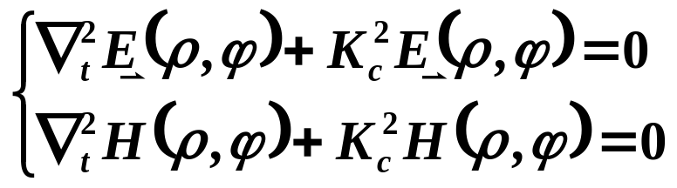
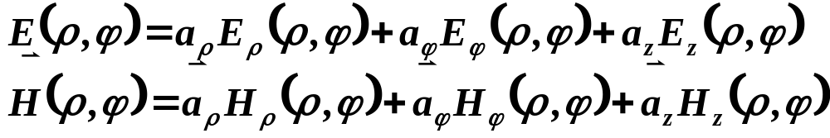
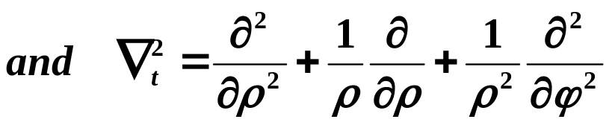
§4-5 Coaxial Line
Coaxial line geometry
Supports TEM /TE/TM modes
Employ cylindrical coordinates（ρ,ϕ,z）

Slide 2
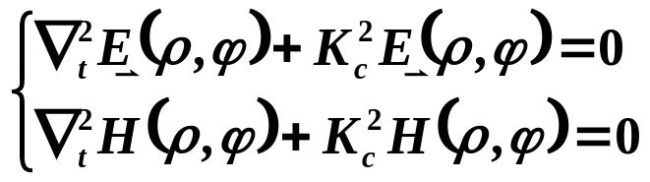
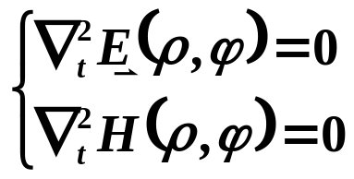
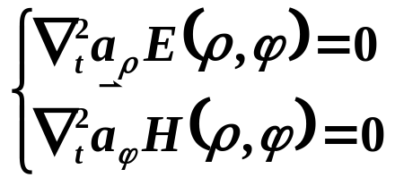
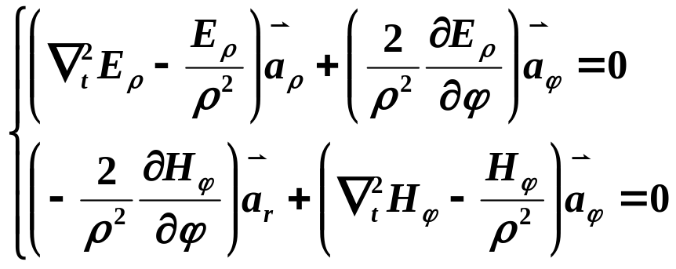
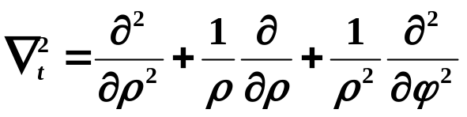
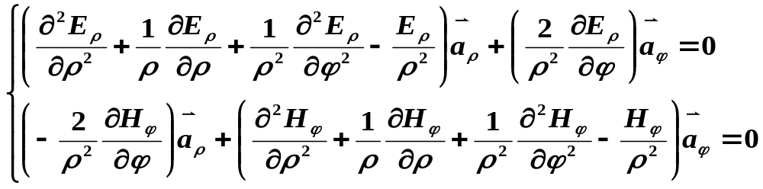
§4-5 Coaxial Line
1. TEM modes
( Ez=0，Hz＝0 )
E_{r} and H_{ϕ} are independent on ϕ

Slide 3
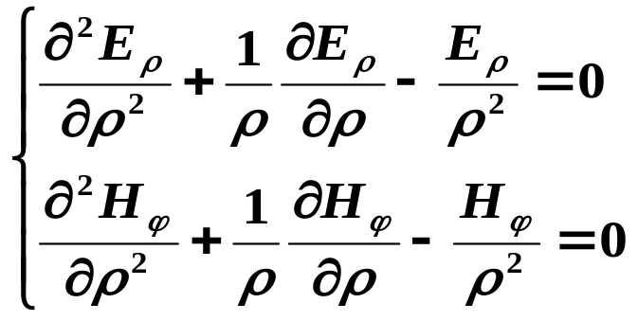
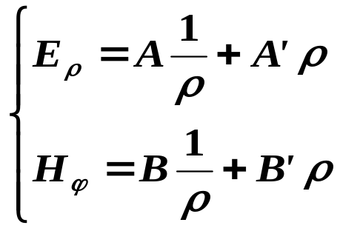
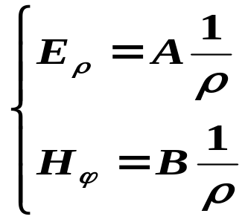
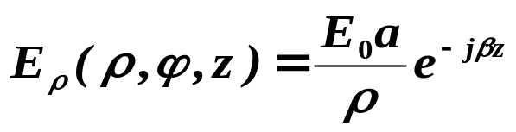

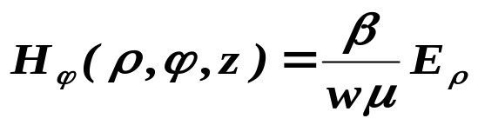
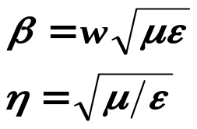
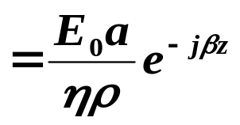
§4-5 Coaxial Line —— 1. TEM modes
Euler Equations
General solution
A’ and B’ should be zeros
Let Er=E₀ @ z=0,ρ=a ，then A＝E₀a

Slide 4
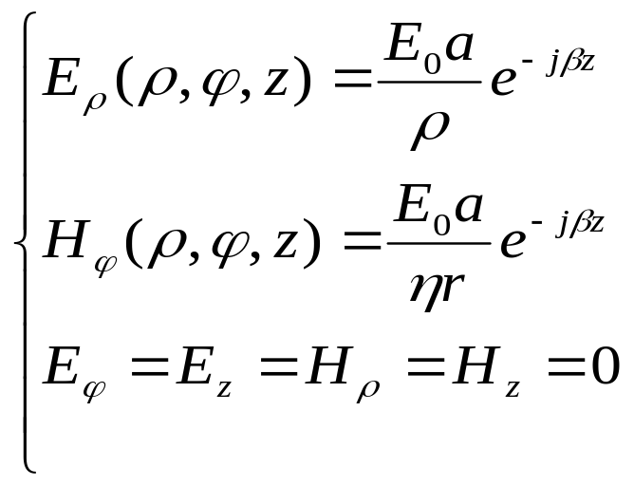
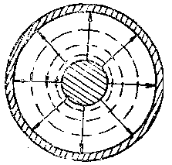
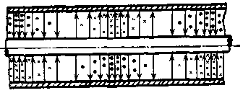
§4-5 Coaxial Line —— 1. TEM modes
Fields in TEM modes in coaxial lines

Slide 5
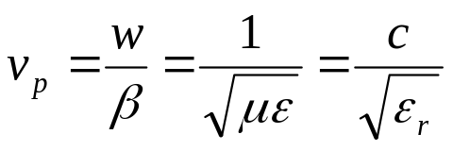
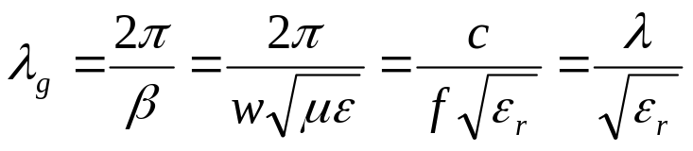
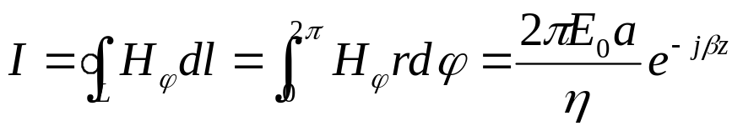
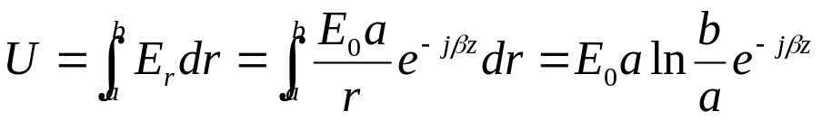
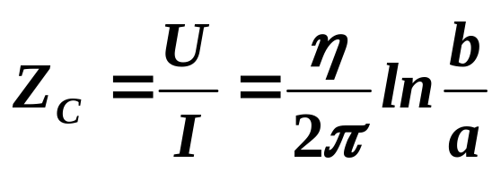
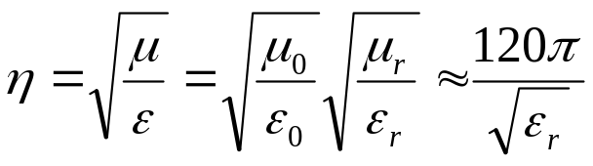
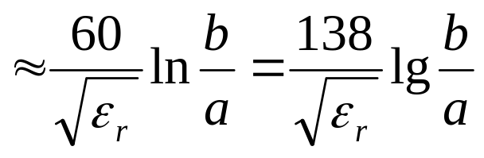
§4-5 Coaxial Line —— 1. TEM modes
Propagation characteristics
（1）
（2）Characteristic impedance

Slide 6
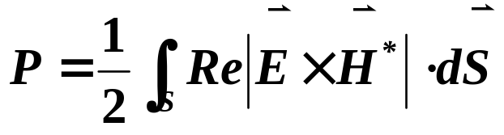
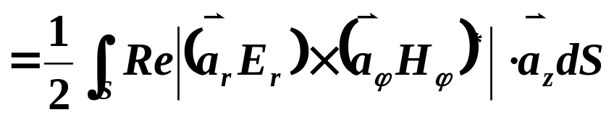
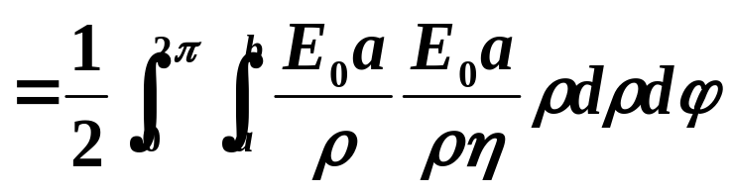
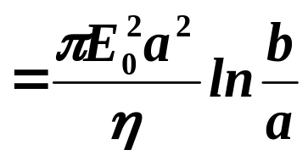
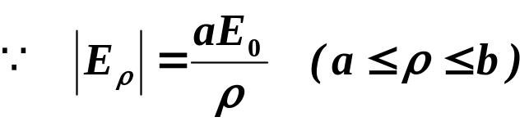
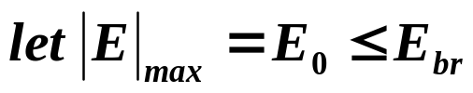
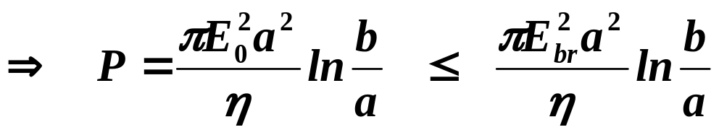
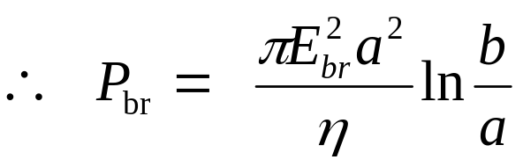

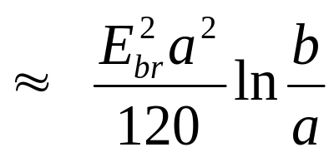
§4-5 Coaxial Line —— 1. TEM modes
（3）Power flow and power handling capacity
Filled with air，

Slide 7
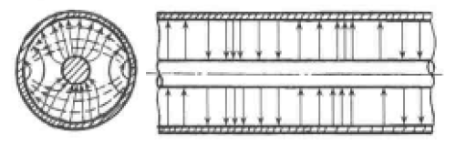
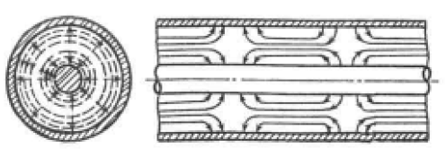
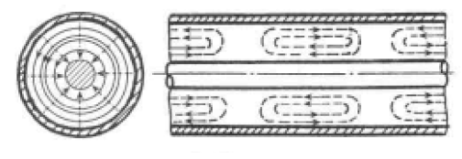
§4-5 Coaxial Line
2. Higher order modes
The coaxial line can support TE and TM waveguide modes in addition to a TEM mode. It is important to be aware of the cutoff frequency of the lowest order waveguide-type modes
TE₁₁
TM₀₁
TE₀₁

Slide 8
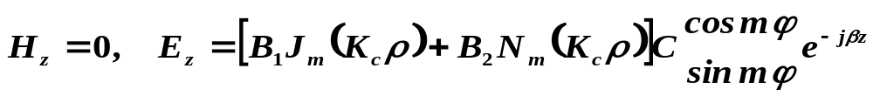

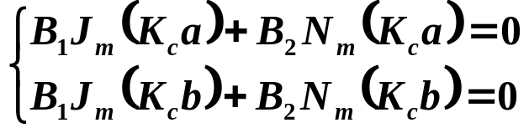
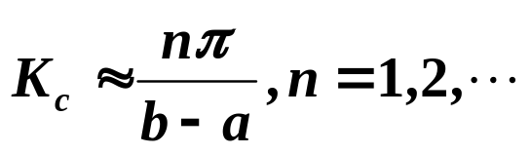
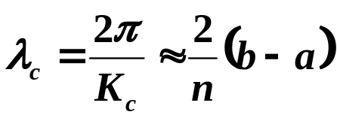
§4-5 Coaxial Line —— 2. higher order modes
（1）TM
Kc：
Let p=b/a
TM₀₁ is the lowest order TM mode，
λc ≈ 2(b-a)

Slide 9
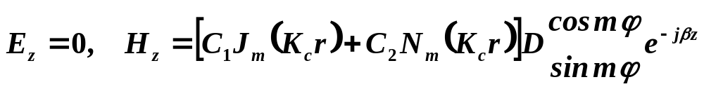
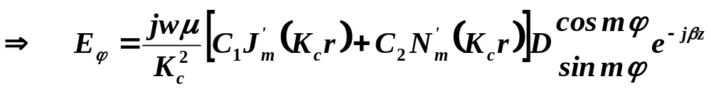

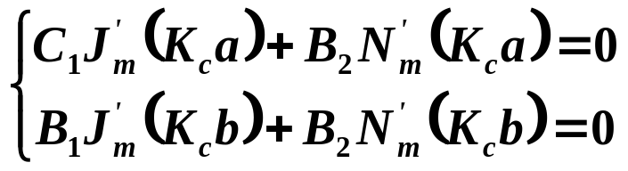
§4-5 Coaxial Line —— 2. higher order modes
（2）TE
Kc：
Let p=b/a

Slide 10
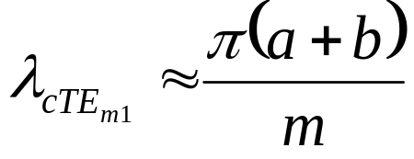
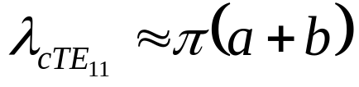
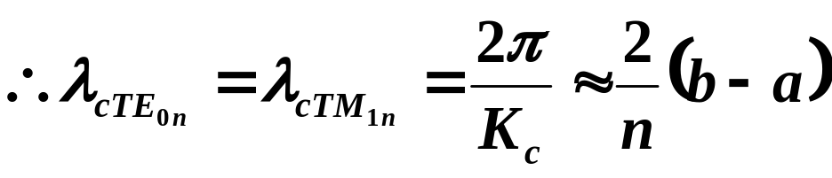
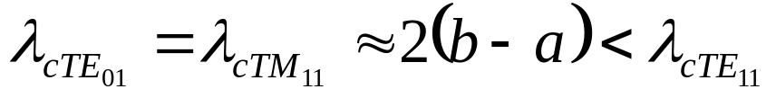
§4-5 Coaxial Line —— 2. higher order modes
when m≠0（m=1,2,3…），n＝1
TE₁₁ is the dominant waveguide mode of the coaxial line,
λ_{c} ≈ π(a+b)

Slide 11






§4-5 Coaxial Line
3. Size
（1）Single mode
（2）Power capacity
If filled with air, then

Slide 12






§4-5 Coaxial Line
（3）Loss
if filled with air
（4）Compromise

Slide 13

§4-5 Coaxial Line
4. Coaxial Connectors
Type-N、TNC、SMA、APC－7 and 2.4mm

